Slide 1

RISK AND RESILIENCE BOOTCAMP
5

Slide 2
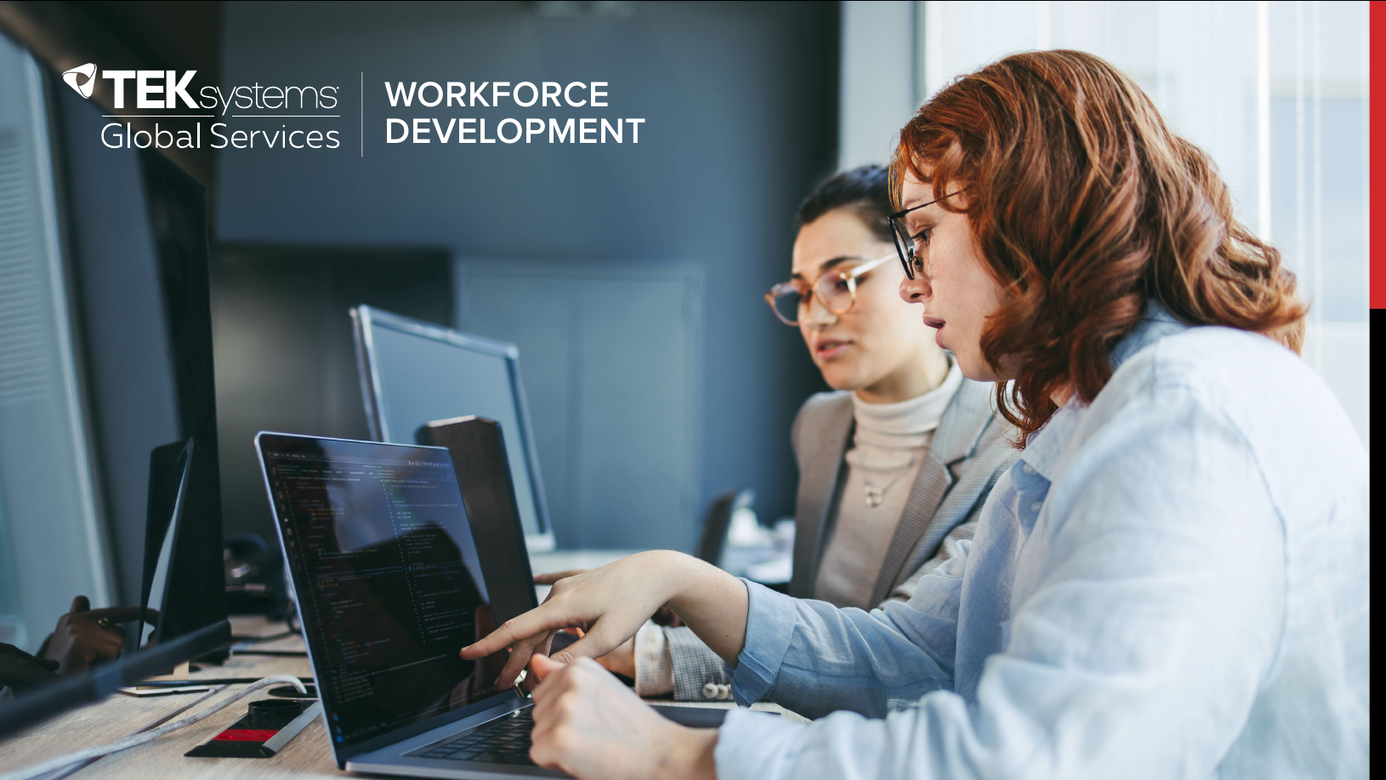

Slide 3
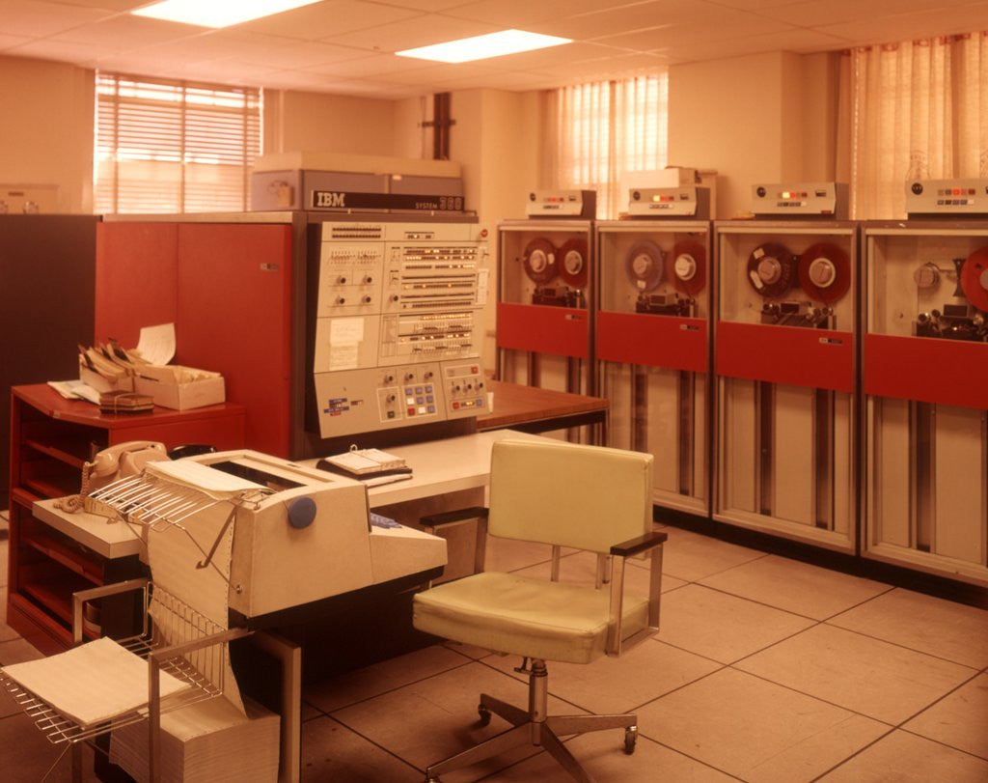
Legacy systems
This section is an introduction to legacy systems
What they are
The IT challenge of legacy systems
The risk and resilience issues associated with legacy systems

Slide 4
Defining legacy system
Systems, applications, or infrastructure that continue to be in use despite being outdated or replaced by newer technologies
Characteristics
Often run on old hardware or software that is no longer supported by vendors
Difficult to modify or integrate with modern infrastructure
Critical to operations; the business can’t function without it
Why they persist
Cost, complexity, business dependency, data lock-in, lack of replacement skills
They are often very complex and tightly integrated into IT infrastructure
Migration to a new system is often prohibitive because of the cost and size of the project
Often requires legacy technical skills that may not currently exist in the organization

Slide 5
legacy system Generations
There have been a number of “generations” of systems development
For example
Mainframes from the 1960-1980s
Object oriented web based systems from the 1990s-2010s
Big data and streaming systems 2010s-current
An organization often has a mix of legacy systems
From different generations of development
A legacy era has its own characteristics
Principles for designing systems architecture
Programming tools, languages and best practices for program design
Models for interacting with data and other systems
Development, testing and deployment methodologies

Slide 6
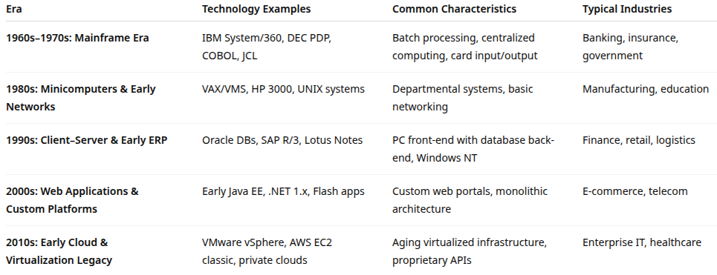
Eras of Legacy Systems

Slide 7
Legacy systems in use
Mainframe-based systems
For example: COBOL based banking systems, airline reservation systems
Outdated databases
For example: Oracle 8i, Sybase, DB2 z/OS, archaic network and hierarchical databases
Monolithic applications
For example: Large enterprise resource planning or customer relationship management systems that are monolithic and resist modularization
Custom-built software with no documentation
For example: Contracted software delivered with a support agreement instead of documentation and source code, common practice for projects in 1960s-1990s
For example: In house software that was never properly documented

Slide 8
Legacy systems in use
Unsupported hardware
For example: proprietary industrial controllers, device drivers
Older operating systems
For example: Windows XP, AIX 5L, Solaris
Legacy network protocols
For example: SNMPv1, Telnet, FTP

Slide 9
Legacy system longevity
High replacement cost
Replacing a legacy system can incur high costs along many dimensions
For example: hardware, software, migration, and retraining costs
ROI may not be immediate, especially if the legacy system still works
Common to defer modernization because budgets favor short-term operational spending over large transformation projects
Example
A large insurance company may still use a COBOL-based policy system because the cost of rewriting and testing all its business rules is prohibitive

Slide 10
Legacy system longevity
Mission critical dependence
Often perform core mission critical business functions
Deeply embedded in daily operations
Even brief outages can cause massive disruption
The mindset is often, ‘If it isn’t broken, don’t fix it.’
Example
Airlines and banks rely on decades-old mainframes that process millions of daily transactions reliably

Slide 11
Legacy system longevity
Reliability and stability
Legacy systems are reliable; they often have run for decades without major failures
Known performance under load and mature processes help with operations planning
Replacing them can introduce instability.
Example
COBOL batch jobs running since the 1980s still process overnight settlements successfully

Slide 12
Legacy system longevity
Data lock-in and integration complexity
Critical historical or regulatory data may reside in legacy databases
Data may be in formats, data models, or implementations that are hard to migrate safely
Modern systems might not be compatible with older data structures
Integrating or converting decades of data can risk data loss or corruption
Example
Government systems holding citizen records in mainframe files that can’t easily be ported to relational databases

Slide 13
Legacy system longevity
Business process entrenchment
Often tightly intertwined with business processes, policies, and staff routines
Replacement may require business re-engineering, retraining, and workflow redesign, not just new IT systems
Organizational inertia resists these changes because of perceived costs, potential down-time and loss of productivity during the transition
Example
A logistics firm’s custom-built dispatch application mirrors decades of operational practices that no modern alternative can duplicate

Slide 14
Legacy system longevity
Lack of suitable replacements
There may be no modern equivalent that can fully replace legacy functionality or compliance requirements
Custom logic built over years can’t easily be reproduced in off-the-shelf systems
The costs of rewriting custom logic may be prohibitive
Example
Nuclear facility monitoring systems or legacy SCADA software that control specialized equipment

Slide 15
Legacy system longevity
Compatibility dependencies
Other systems often depend on legacy interfaces, file formats, or protocols
Removing one legacy component might break dozens of connected systems or scripts
Example
Old ERP modules still in use because other downstream systems rely on their flat-file outputs

Slide 16
Legacy system longevity
Vendor lock-in
Proprietary platforms can make it expensive or technically difficult to migrate away
Licensing and support contracts may force staying with legacy solutions rather than replacing
Example
Organizations tied to specific IBM or Oracle mainframe environments

Slide 17
Legacy system longevity
Skills availability
Organizations have staff who are experienced with the legacy technology
This allows them to maintain it reliably
Converting to new technology would require staff with new skill sets
Downside: What happens when the staff with the legacy skills retire?
Example
A financial institution retaining COBOL developers nearing retirement because the cost of retraining new staff on modernization tools is higher
Still have to deal with the loss of the programmers after they retire

Slide 18
Legacy system longevity
Regulatory and compliance requirements
Legacy systems may be certified or approved for regulated use
For example: defense, healthcare, aviation or environment with high security requirements
Replacements would need to go through costly recertification or revalidation
Organizations keep the old system running within a controlled, compliant environment
Example
Medical imaging systems that meet FDA approval under specific software versions

Slide 19
Legacy Systems Still in Use
Banking
COBOL-based core banking still running on mainframes in large banks (e.g., JPMorgan Chase, Bank of America)
Risk:
Shortage of COBOL developers, integration complexity, high operational risk
Resilience factor:
Proven reliability, decades of uptime, transaction integrity

Slide 20
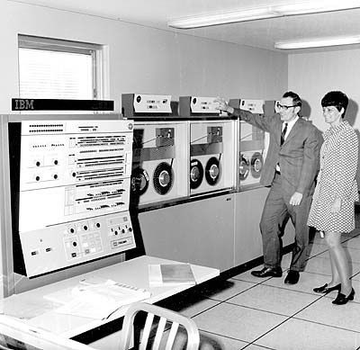
Legacy Systems Still in Use
Government Systems:
U.S. IRS and Social Security still depend on 1970s-era mainframes.
Risk:
High maintenance costs, cybersecurity gaps, data integration issues
Resilience issue
Difficulty scaling for new service demands

Slide 21
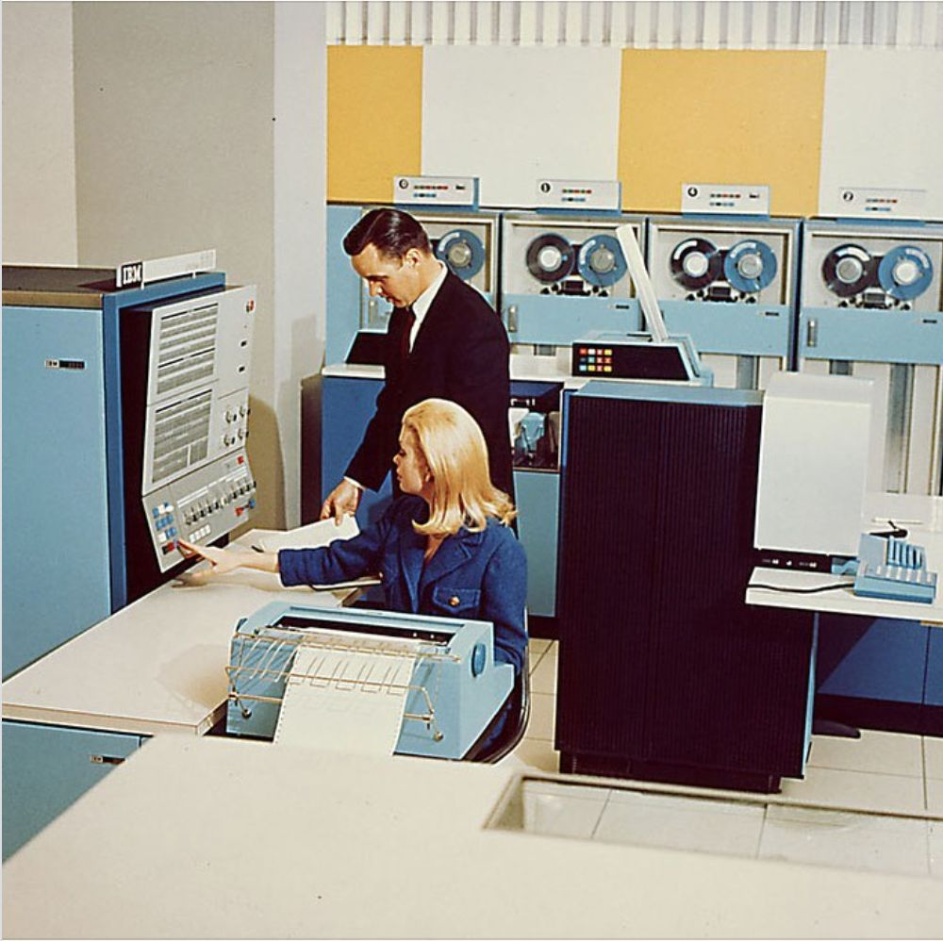
Legacy Systems Still in Use
Airline Industry:
SABRE reservation system (1950s origin, IBM mainframe roots)
Risk:
Complex dependency chains; single-point failures have caused major outages
Resilience issue:
Modernization attempts risk service disruption

Slide 22
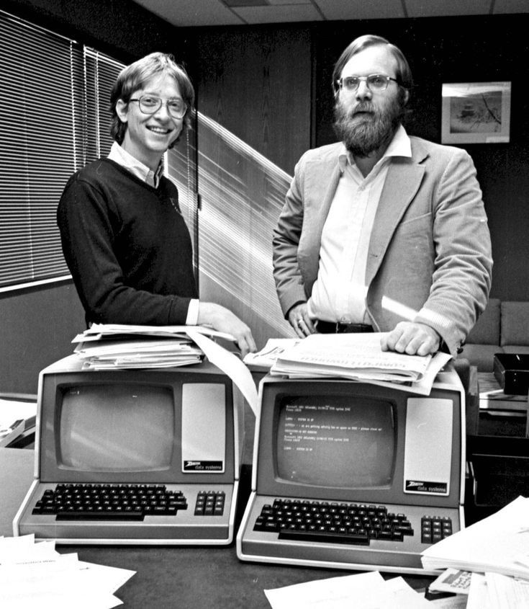
Legacy Systems Still in Use
Healthcare:
Hospital record systems using legacy Windows servers and outdated medical devices
Risk:
Compliance exposure (HIPAA), vulnerability to ransomware
Resilience issue:
Data migration difficulty; limited downtime windows

Slide 23

Legacy Systems Still in Use
Industrial/OT Environments:
Power grids and manufacturing plants using SCADA systems built in the 1980s-90s
Risk:
Insecure protocols, physical process disruption potential
Resilience issue:
Patching can disrupt production; reliance on physical redundancy

Slide 24
Legacy system risk
Operational risk
The risk that legacy systems fail to operate as intended due to aging components, obsolete dependencies, or lack of available spare parts
How it can occur:
Hardware failure in outdated servers, storage arrays, or networking gear that is no longer manufactured
Software instability due to untested patches or operating systems no longer maintained
Downtime caused by failure in components that can’t easily be replaced or replicated
Inability to restore operations quickly after an incident due to lack of recovery media or compatible hardware
Example:
A government tax agency running a 1980s mainframe suffers a hardware failure; replacement parts are only available through eBay or custom refurbishers, leading to weeks of downtime
Resilience Impact:
Low adaptability and recovery speed
Systems may be stable in day-to-day use but highly brittle under stress, creating single points of failure

Slide 25
Legacy system risk
Cyber risk
The risk of security compromise stemming from unpatched vulnerabilities, outdated cryptographic protocols, or unsupported software components
How it can occur
Inability to apply modern security patches because the OS or application is out of support
Use of insecure network services (e.g., Telnet, FTP, SMBv1)
Lack of encryption or modern authentication mechanisms
Older firmware that can’t be monitored by current intrusion detection systems
Legacy systems serving as “soft targets” or entry points for attackers
Example:
During the 2017 WannaCry ransomware outbreak, many healthcare systems were compromised because they still ran Windows XP, which was no longer supported or patched at the time
Resilience Impact:
Weakens the overall security posture of the organization and increases incident likelihood. Once compromised, legacy systems are often hard to recover or rebuild, compounding the damage

Slide 26
Legacy system risk
Compliance risk
The risk of violating current legal, regulatory, or industry requirements due to the legacy system’s inability to meet modern compliance standards
How it can occur:
Failure to comply with data protection laws (e.g., GDPR, HIPAA) due to lack of encryption, audit trails, or access controls
Inability to produce required records or logs during audits
Use of outdated algorithms or storage mechanisms that violate current standards
Certification or accreditation (e.g., PCI DSS) lost due to unsupported software or unverified security controls
Example:
A regional bank’s transaction processing system stores customer data in plaintext files. Under new data privacy regulations, this storage method violates encryption requirements
Resilience Impact:
Legal exposure, financial penalties, and reputational damage erode organizational resilience
Maintaining compliance requires either compensating controls or accelerated modernization

Slide 27
Legacy system risk
Vendor dependency (lock-in risk)
The risk arising from overreliance on a single vendor or proprietary technology that cannot be easily replaced or supported by others.
How it can occur:
Vendor stops providing updates or support (end-of-life declaration)
Escalating maintenance costs due to exclusive vendor control
Inability to migrate data or interfaces because of proprietary formats
Delays in incident resolution when vendor assistance is unavailable or slow
Example:
A manufacturing company relies on an industrial control system that only one vendor can service
When the vendor is acquired and discontinues the product, the company faces unplanned obsolescence
Resilience Impact:
Creates single points of dependency that undermine operational flexibility
If the vendor collapses or changes terms, the organization’s critical operations are directly exposed

Slide 28
Legacy system risk
Integration Risk
The risk that legacy systems cannot effectively interface with new technologies, cloud platforms, or data ecosystems, creating operational silos or broken workflows
How it can occur:
Legacy applications that lack APIs or modern interface standards
Incompatibility with cloud migration efforts (e.g., no containerization support)
Manual data transfer between systems leading to errors and delays
High complexity in integration projects leading to scheduling or cost overruns
“Shadow IT” workarounds to bridge systems informally, introducing new risks
Example:
A logistics company attempts to link its 1990s warehouse management software to a new SaaS analytics dashboard but must rely on nightly flat-file exports due to lack of API support
Resilience Impact:
Reduces organizational agility and visibility, hindering coordinated responses during incidents
Inability to integrate with newer monitoring, backup, or automation tools weakens resilience

Slide 29
Legacy system risk
Skill risk (knowledge and workforce risk)
The risk of operational failure or business disruption caused by the loss of personnel who understand and can maintain the legacy system.
How it can occur:
Retirement or departure of long-time staff who built or maintained the system
Inadequate documentation or institutional memory
Difficulty finding new talent trained in obsolete technologies (e.g., COBOL, PowerBuilder, VAX/VMS)
Over-reliance on a few experts (“key-person risk”)
Example:
A telecom company’s billing platform runs on an aging UNIX variant
Only two engineers know its configuration; one retires and the other moves on, leaving no internal capability for updates
Resilience Impact:
Severely limits the organization’s ability to adapt, recover, or troubleshoot failures
Skills loss magnifies every other risk category: operational, cyber, and compliance

Slide 30
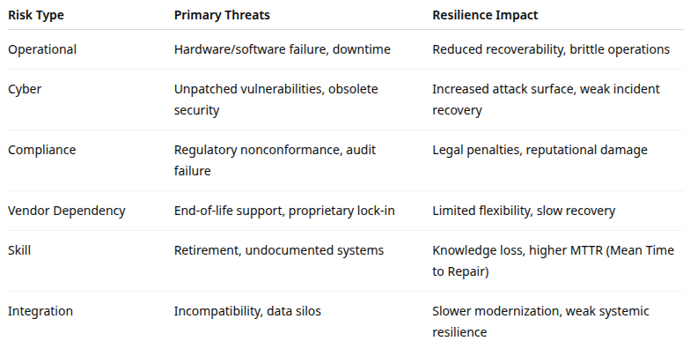
Legacy system risk

Slide 31
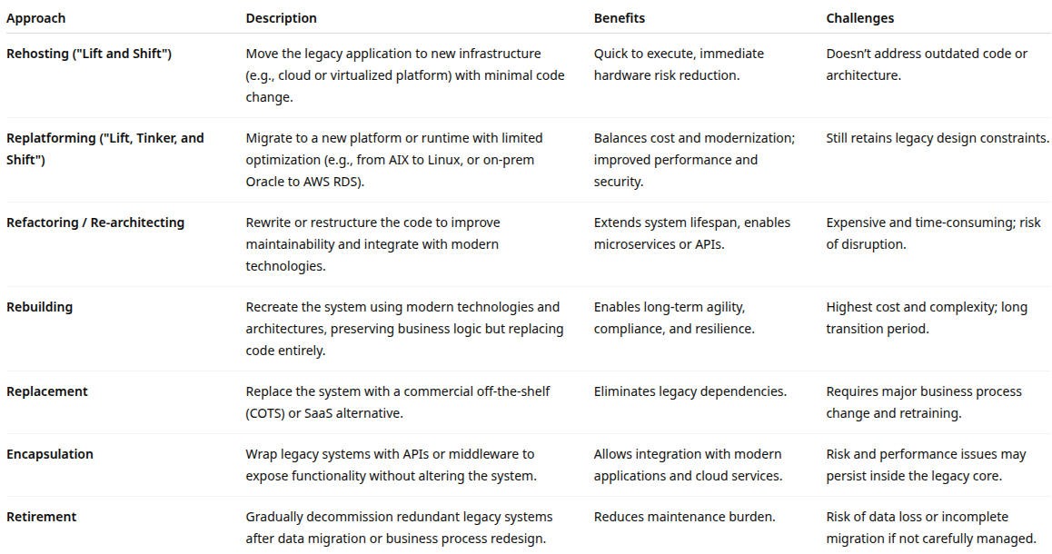
Legacy phase out

Slide 32
Risk Mitigation
Security hardening
Network segmentation
Isolate legacy systems from the internet and modern networks
Access control and monitoring
Implement firewalls, multi-factor authentication, and strict logging
Virtual patching
Use intrusion prevention systems to block exploits when patches can’t be applied
Application firewalls or proxies:
Filter unsafe traffic to or from legacy interfaces
Example
A bank maintains a COBOL mainframe but isolates it on a restricted subnet and monitors access through a SIEM (Security Information and Event Management) platform

Slide 33
Risk Mitigation
Data protection and backups
Implement modern backup solutions even for legacy environments
Store critical data in interoperable, exportable formats (CSV, XML, or JSON)
Introduce regular recovery drills to test recovery speed and completeness
Resilience Effect:
Improves recovery capability and ensures data continuity in case of failure or ransomware attack
Documentation and knowledge preservation
Capture institutional knowledge before key staff retire
Document workflows, configurations, and dependencies
Use knowledge management tools and automated documentation extractors
Resilience Effect
Prevents “key-person risk” and ensures continuity when maintaining or migrating systems

Slide 34
Risk Mitigation
Virtualization and emulation
Run legacy applications on virtual machines or emulators that replicate old hardware environments
Preserves system functionality while allowing modern management tools and redundancy
Example
A manufacturing firm runs a 1990s DOS-based control system in a virtualized sandbox on modern hardware, ensuring continued support without physical dependence on aging equipment
Controlled modernization (“Strangler Pattern”)
Introduce new modules alongside the legacy system
Gradually replace or bypass old functions without a “big bang” rewrite
Common in large-scale enterprise or government modernization programs
Resilience Effect
Balances risk by maintaining service continuity while reducing long-term dependency

Slide 35
Risk Mitigation
Skills and vendor support
Partner with specialized vendors or consultants who still support legacy technologies
Create cross-training programs for younger staff.
Maintain small internal “legacy stewardship teams” to ensure stability during transition
Resilience Effect:
Maintains operational knowledge and minimizes disruption risk during modernization

Slide 36
Risk strategy
Governance and risk planning
Establish a legacy modernization roadmap within the organization’s IT risk management framework
Prioritize systems based on criticality, risk exposure, and business impact
Integrate modernization goals into annual IT risk and resilience objectives
Dual-environment operation
Operate old and new systems in parallel for a defined transition period
Enables validation, testing, and fallback capability

Slide 37
Risk strategy
Change management and testing
Introduce automated regression testing for legacy systems before any migration step
Implement continuous monitoring and fallback plans
Compliance Alignment
Map modernization projects to regulatory requirements
Especially data protection and audit trail retention.
Ensure that modernization itself doesn’t create new compliance risks

Slide 38
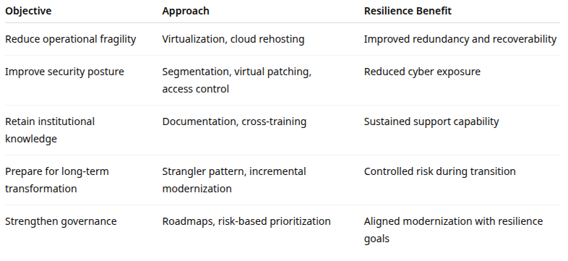
Risk strategy

Slide 39
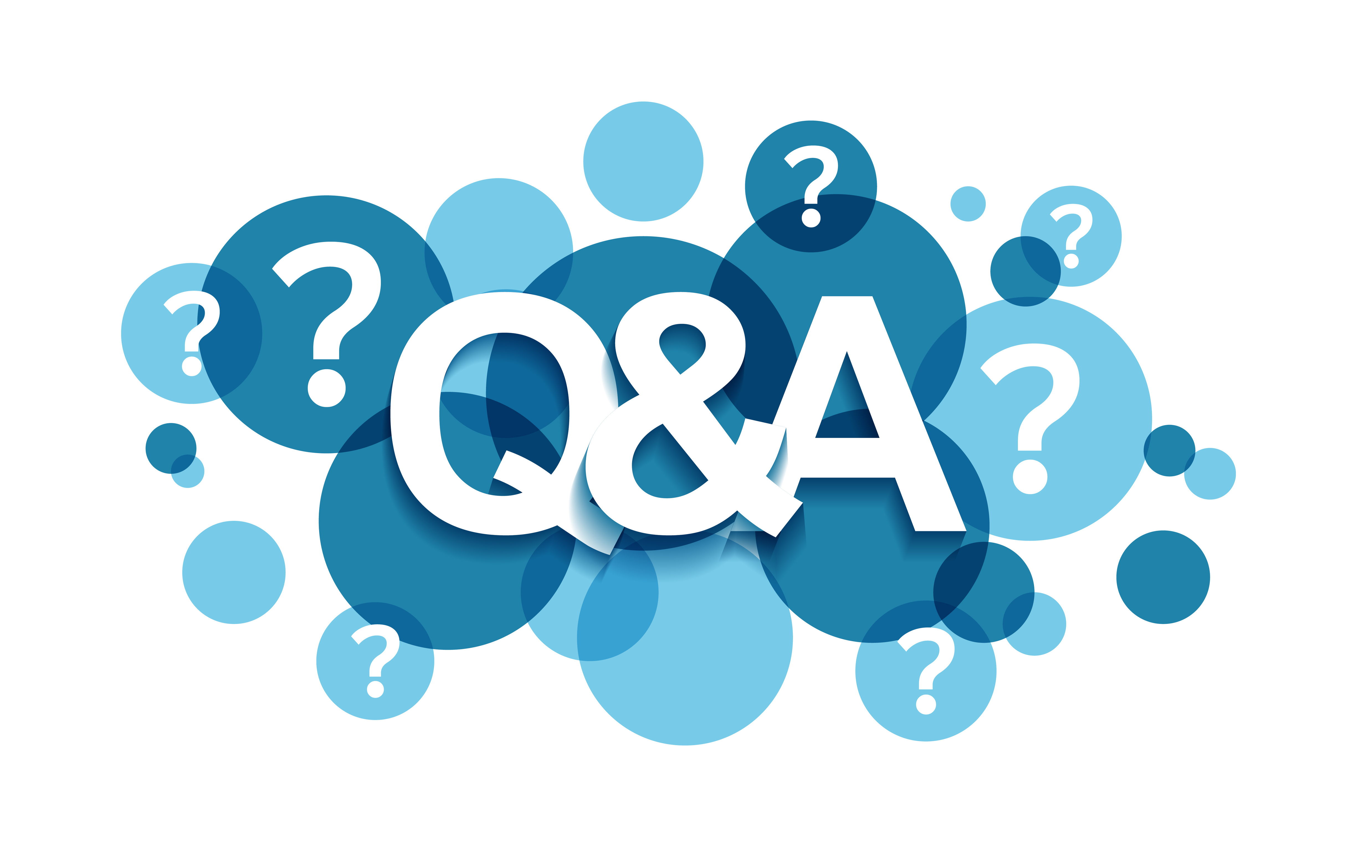
Q&A and open discussion
Notes:
Now is the time to engage in an interactive Q&A session where you can ask questions, share insights, and clarify any doubts about the topics we have covered so far.
This open discussion is designed to ensure that every participant has the opportunity to voice their thoughts and learn from the collective experience of the group.
Your questions and comments are valuable as they help us identify areas that may need further explanation and enable us to tailor future sessions to your needs.
We encourage you to speak up and contribute to the dialogue, as this interaction is one of the key components of our interactive learning approach.
As the session progresses, take note of any questions or ideas that you would like to revisit, and feel free to share your perspectives with the class.

